Slide 1
WELCOME
Class: B.Com – Part-2
Subject: Business Regulatory Framework
TOPIC: Essentials of a Valid Contract
Prepared By
Dr. SHAHID IQBAL
Guest Faculty,
Marwari College, Darbhanga,
Mobile No. and Whatsup No. : 7004160257
Email ID: shahidlnmu@gmail.com

Slide 2
Essentials of a Valid Contract
All agreements are not contracts, only that agreement which is enforceable at law is a contract. An agreement which is not enforceable at law cannot be a contract. Thus, the term agreement is wider in scope than a contract.
All agreement, to be enforceable by law, must possess the essential elements of the valid contract as contained in Section 10 of the Indian Contract Act.
1. Offer and Acceptance: In order to create a valid contract there must be a lawful offer by one party and lawful acceptance of the same by the other party.
For example: ‘A’ offers to sell his motorcycle to ‘B’ for 30,000, ‘B’ agrees to pay Rs. 30,000 for the motorcycle. Here, ‘A’ is the offerer and ‘B’ is the Acceptor

Slide 3
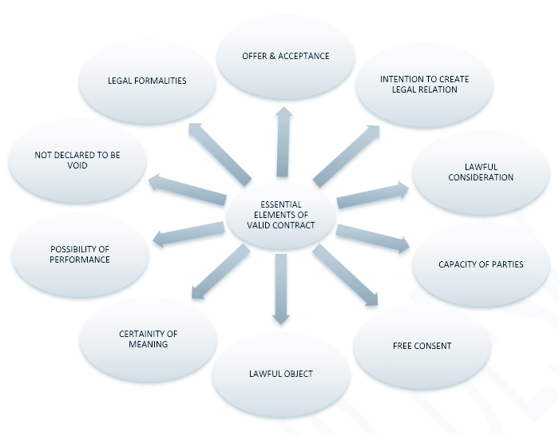

Slide 4
2. Intention to create legal relation: In case, there is no such intention on the part of parties, there is no contract. Agreements of social or domestic nature do not contemplate legal relations.
The leading case on this point is Balfour vs. Balfour (1919)
For example: An agreement to have lunch at a friend’s house is not an agreement intending to create legal relation. Agreement between husband and wife generally lack of intention to create legal relation.
3. Lawful consideration: Consideration is an essential element in a contract. Promises made for nothing are unenforceable under the Indian Contract Act. The law enforces only those promises which are made for consideration. Consideration may take the form of money, goods, services, a promise to marry, etc. it may be past, present or future. But it must be real and lawful.
For example: ‘A’ agrees to sell his house to ‘B’ for Rs. 10, 00,000. Here ‘A’s promise to sell his house is, for ‘B’s consideration to pay Rs 10, 00,000.

Slide 5
4. Capacity of parties: The parties to an agreement must be competent to contract. If either of the parties does not have the capacity to contract, the contract is not valid. According, to section 11 “every person is competent to contract, who is of the age of majority according to the law to which he is subject, and who is of sound mind and is not disqualified from contracting by any law to which he is subject.”
For example: Minors, persons of unsound mind and persons disqualified by law are incompetent to contract.
5. Free consent: ‘Consent’ means the parties must have agreed upon the same thing in the same sense.
For example: ‘A’ who owns two cars, one Volvo and other BMW, offers to sell 'B' one car. ‘A’ intending it to be a Volvo car. ‘B’ accepts the offer thinking that it is the BMW. There is no free consent and hence, no contract.

Slide 6
6. Lawful object: The object of an agreement must be lawful. The object has nothing to do with consideration. It means the purpose or design of the contract.
For example: ’A’ hires a house for use as a gambling house, the object of the contract is to run a gambling house.
7. The certainty of meaning: The terms of the contract must be precise and certain. It cannot be left vague. A contract may be void on the grounds of uncertainty.
For example: ‘X’ promises ‘Y’ that he will be marrying ‘C’ if war breaks out between India and Pakistan. An agreement subject to war clause is too vague to be enforceable contract between ‘X’ and ‘Y’.

Slide 7
8. Possibility of performance: If the act is impossible in itself, physically or legally it cannot be enforceable by law.
For example: Mr. A agrees with Mr. B to discover treasure by magic. Such an agreement is not enforceable.
9. Not declared to be void or illegal: The agreement though satisfying all the conditions for a valid contract must not have been expressly declared void by any law in force in the country.
For example: Agreements in restraint of trade, marriage, legal proceedings etc.

Slide 8
10. Legal formation: An oral contract is a perfectly valid contract except in those cases where writing, registration etc are required.
For example: In India writing is required in cases of sale, mortgage, lease, negotiable instrument etc.
Therefore, All the elements mentioned above must be present in order to make a valid contract. If anyone of them is absent the agreement does not become a contract.

Slide 9
Thank You

